Slide 1
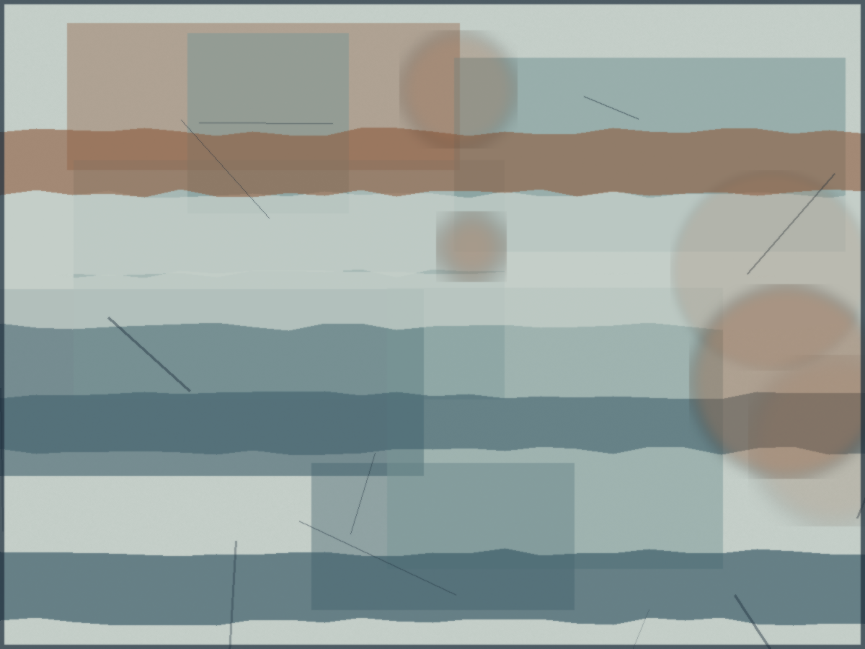
ATELIER LITORAL RESIDENCY | PORTO, PORTUGAL
Tidal Registers
A residency proposal extending a long interest in industrial waterfronts from the Delaware River to the Douro estuary.
Application by Nancy Crawford, Philadelphia. Spring 2027 cohort, March to May 2027. Eight weeks, self-funded travel.

Slide 2
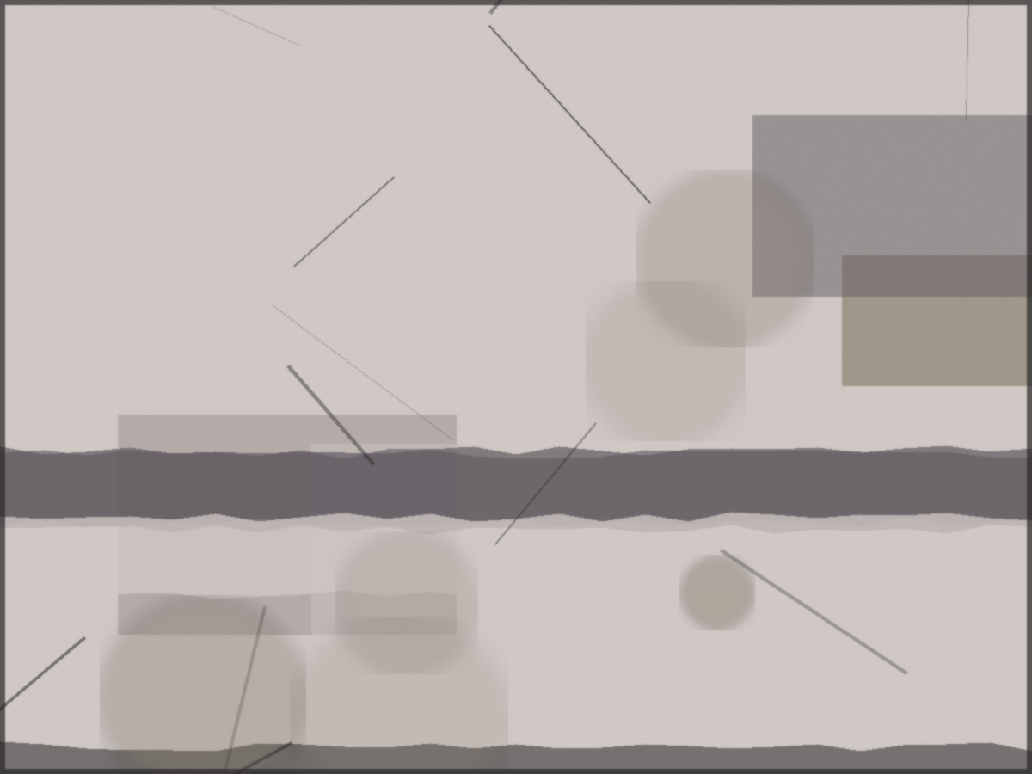
ABOUT THE ARTIST
Thirty years at the water's edge
Mixed-media artist in printmaking, collage, and found materials, based in Philadelphia.
MFA, Northfield Institute of the Arts. Three decades exhibiting in Philadelphia and Brooklyn.
Represented by Ironwork Gallery, Philadelphia, and Sable and Thread Gallery, Brooklyn.
Reads French at conversational fluency; building working Portuguese for source reading.
Tidal Registers | Nancy Crawford | Residency application
2 / 10

Slide 3
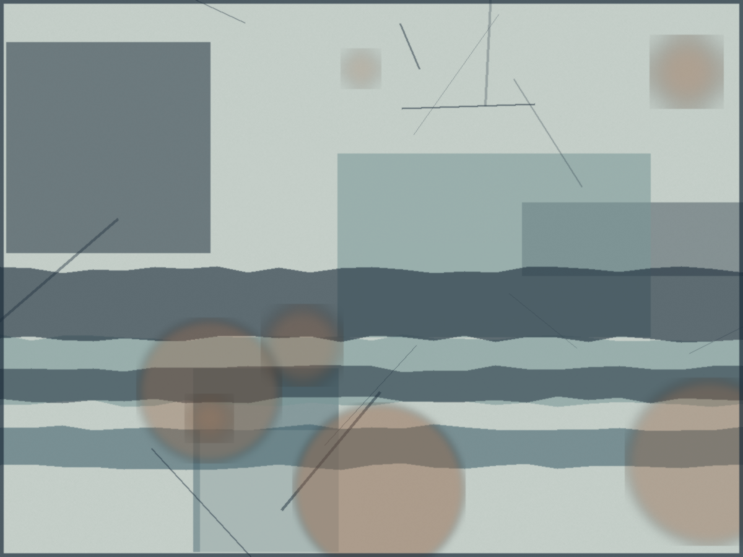
PROJECT PROPOSAL
Tidal Registers
Tidal Registers extends my work on industrial waterfronts from the Delaware River in Philadelphia to the Douro estuary in Porto. I would gather found papers, rust, and printed ephemera along the river and translate them into a series of layered works on paper. The two rivers share an industrial memory and a particular northern light. The residency would let me read one against the other, away from the pull of the local calendar.
Tidal Registers | Nancy Crawford | Residency application
3 / 10

Slide 4
WHY PORTO, WHY NOW
The right moment
The river
The studio
The calendar
The Douro estuary and its working edge are a close echo of the Delaware riverfront.
The residency print facilities fit the next phase of the work directly.
Spring 2027 falls between teaching terms, after a solo show and a delivered commission.
Tidal Registers | Nancy Crawford | Residency application
4 / 10

Slide 5
METHODOLOGY
Gather, print, translate
Gather
Walk the Douro edge; collect papers, rust, and ephemera, logged by place and date.
Print
Pull monotypes from collected surfaces in the residency print studio.
Translate
Layer Porto and Philadelphia material in paired registers.
Reflect
Keep a process journal; read French and Portuguese source texts alongside the work.
Tidal Registers | Nancy Crawford | Residency application
5 / 10

Slide 6
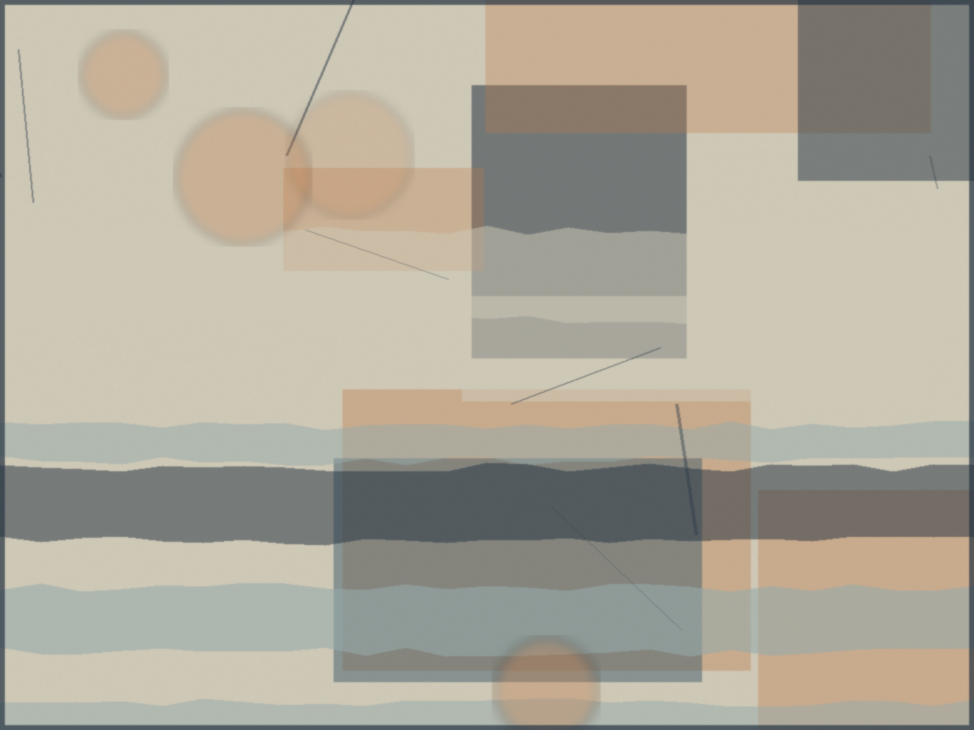
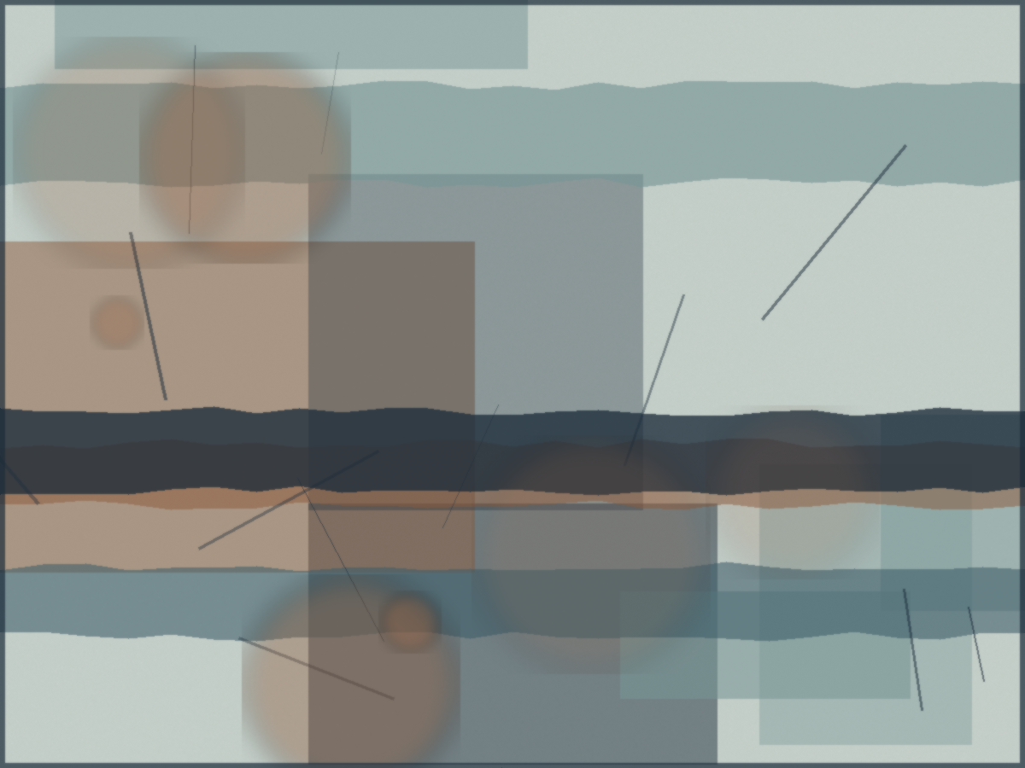
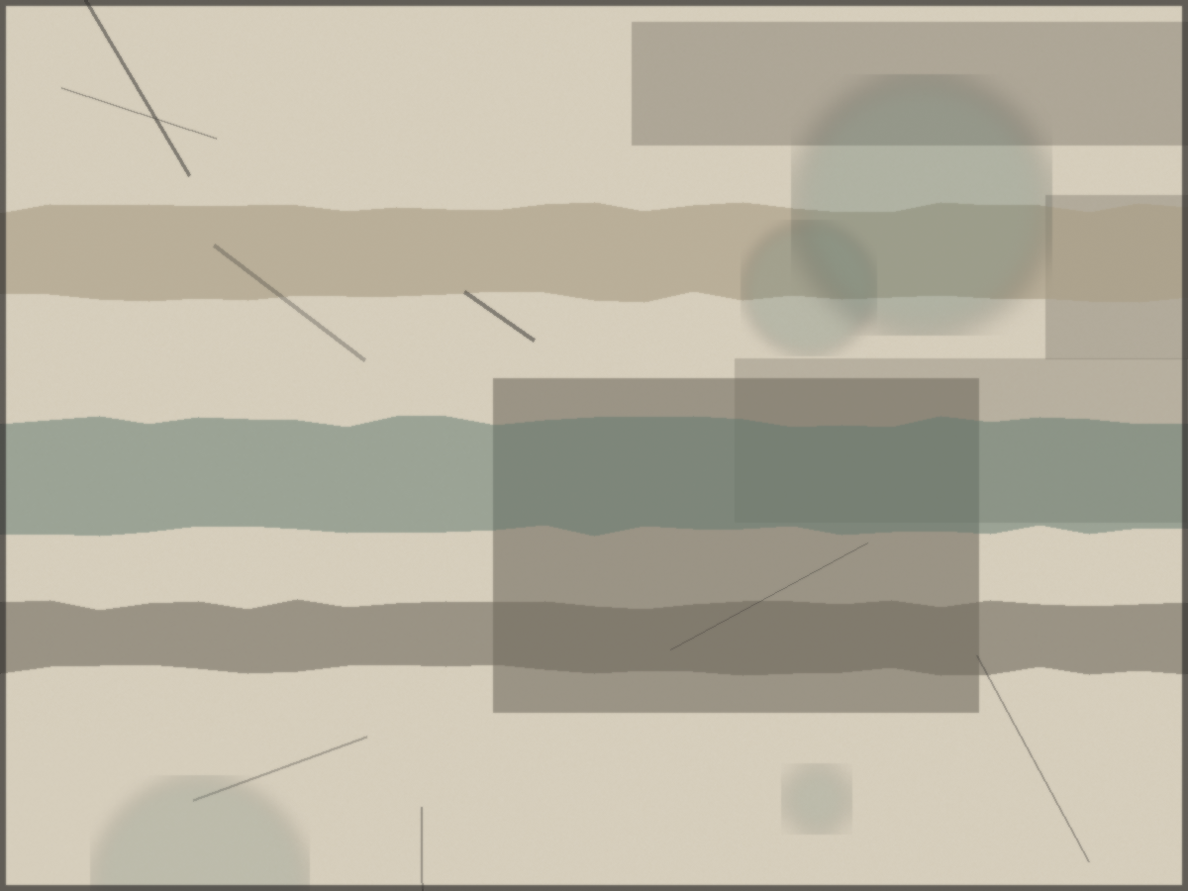
RELATED WORK
From the Delaware series
Tide Register I
Schuylkill Trace
Delaware Edge
Penn Treaty Morning
Tidal Registers | Nancy Crawford | Residency application
6 / 10

Slide 7
EIGHT WEEK PLAN
March to May 2027
Weeks 1 to 2
Settle, walk the estuary, begin gathering and logging material.
Weeks 3 to 5
Core printmaking and the first paired registers in the studio.
Weeks 6 to 7
Layering, editing, and a small set of resolved works on paper.
Week 8
Open studio, documentation, and notes toward the next body of work.
Tidal Registers | Nancy Crawford | Residency application
7 / 10

Slide 8
OUTCOMES
What the residency produces
A series of eight to twelve resolved works on paper pairing the Douro and the Delaware.
A documented body of source material and monotype plates for ongoing studio use.
A process journal and reading notes in French and Portuguese.
A short open studio and full photographic documentation for the gallery and portfolio.
Tidal Registers | Nancy Crawford | Residency application
8 / 10

Slide 9
LOGISTICS
Self-funded and self-sufficient
Dates
Full eight weeks of the spring 2027 cohort, March to May.
Travel
From Philadelphia by a connecting flight to Porto, self-funded.
Support
No studio assistance required beyond print facility access.
Request
Application for the partial materials stipend only.
Tidal Registers | Nancy Crawford | Residency application
9 / 10

Slide 10
At the water's edge
Thank you for considering this application. I would welcome the chance to work in Porto.
Nancy Crawford | nancy.crawford@finthesiss.ai
References: Kim Albright, Ironwork Gallery, and a former faculty colleague.

